Slide 1
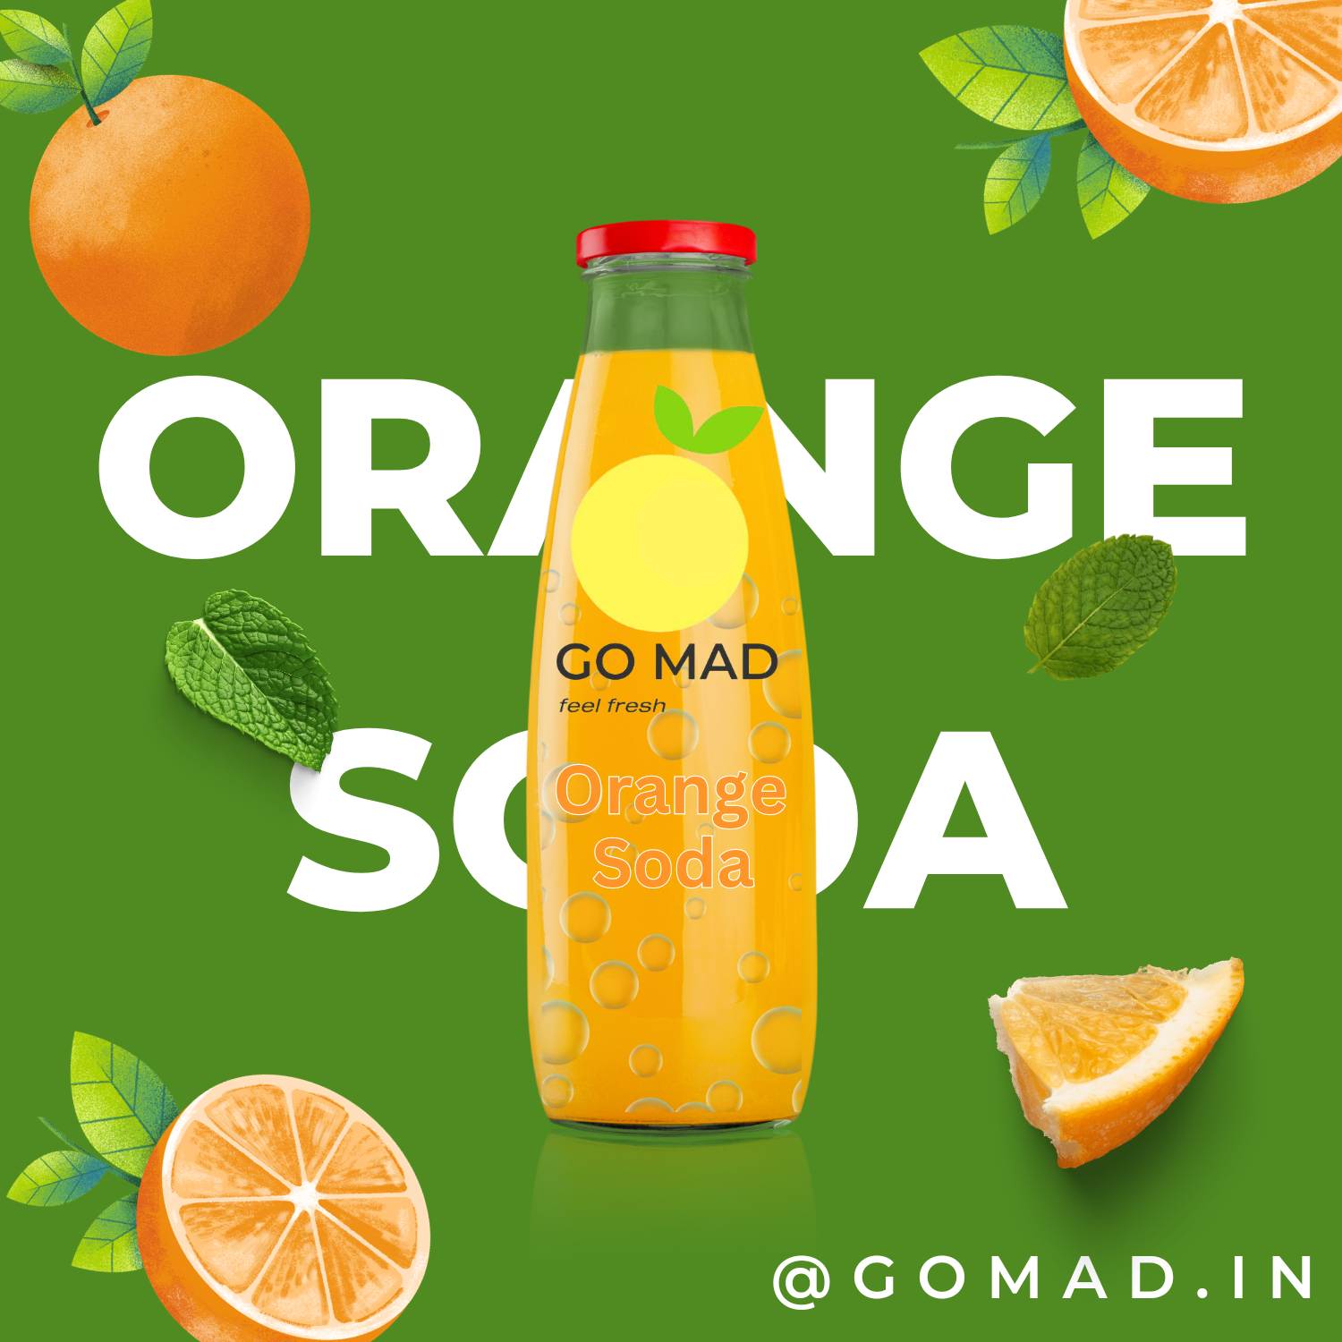

DIGITAL AND SOCIAL MEDIA
GO MAD

Slide 2
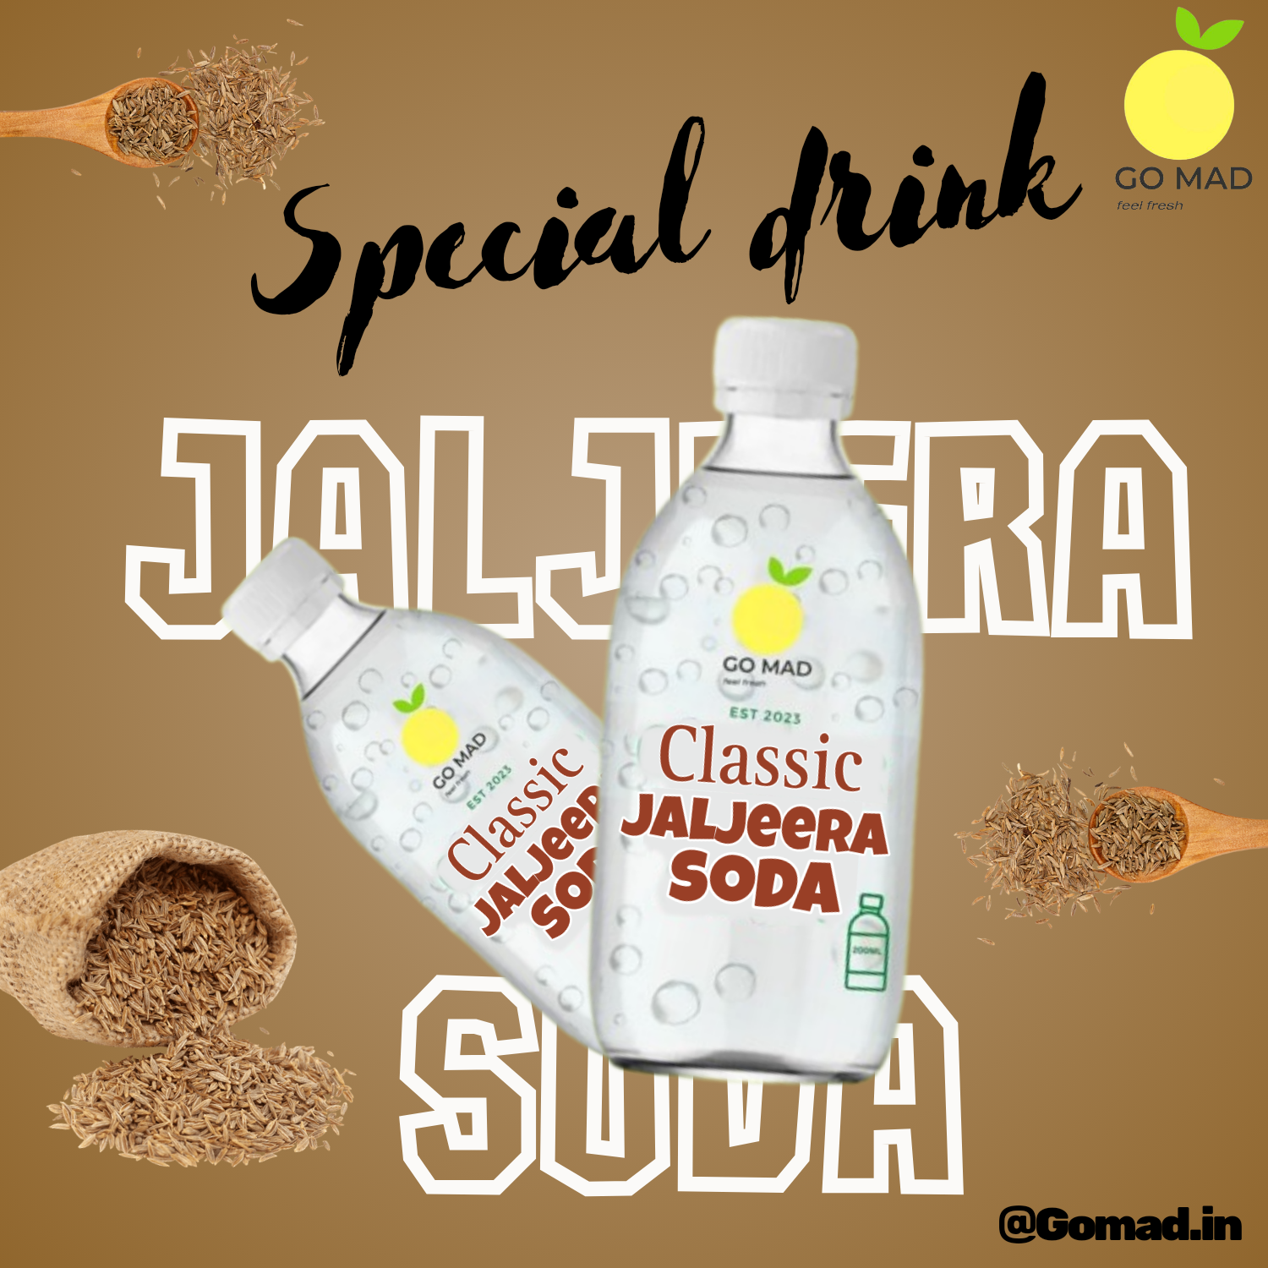
Team Members
Kasinath V
Monesh N
A Vasu
Joseph Kumar
Siva Prakash
Praneeth kumar
Konda Vihar

Slide 3
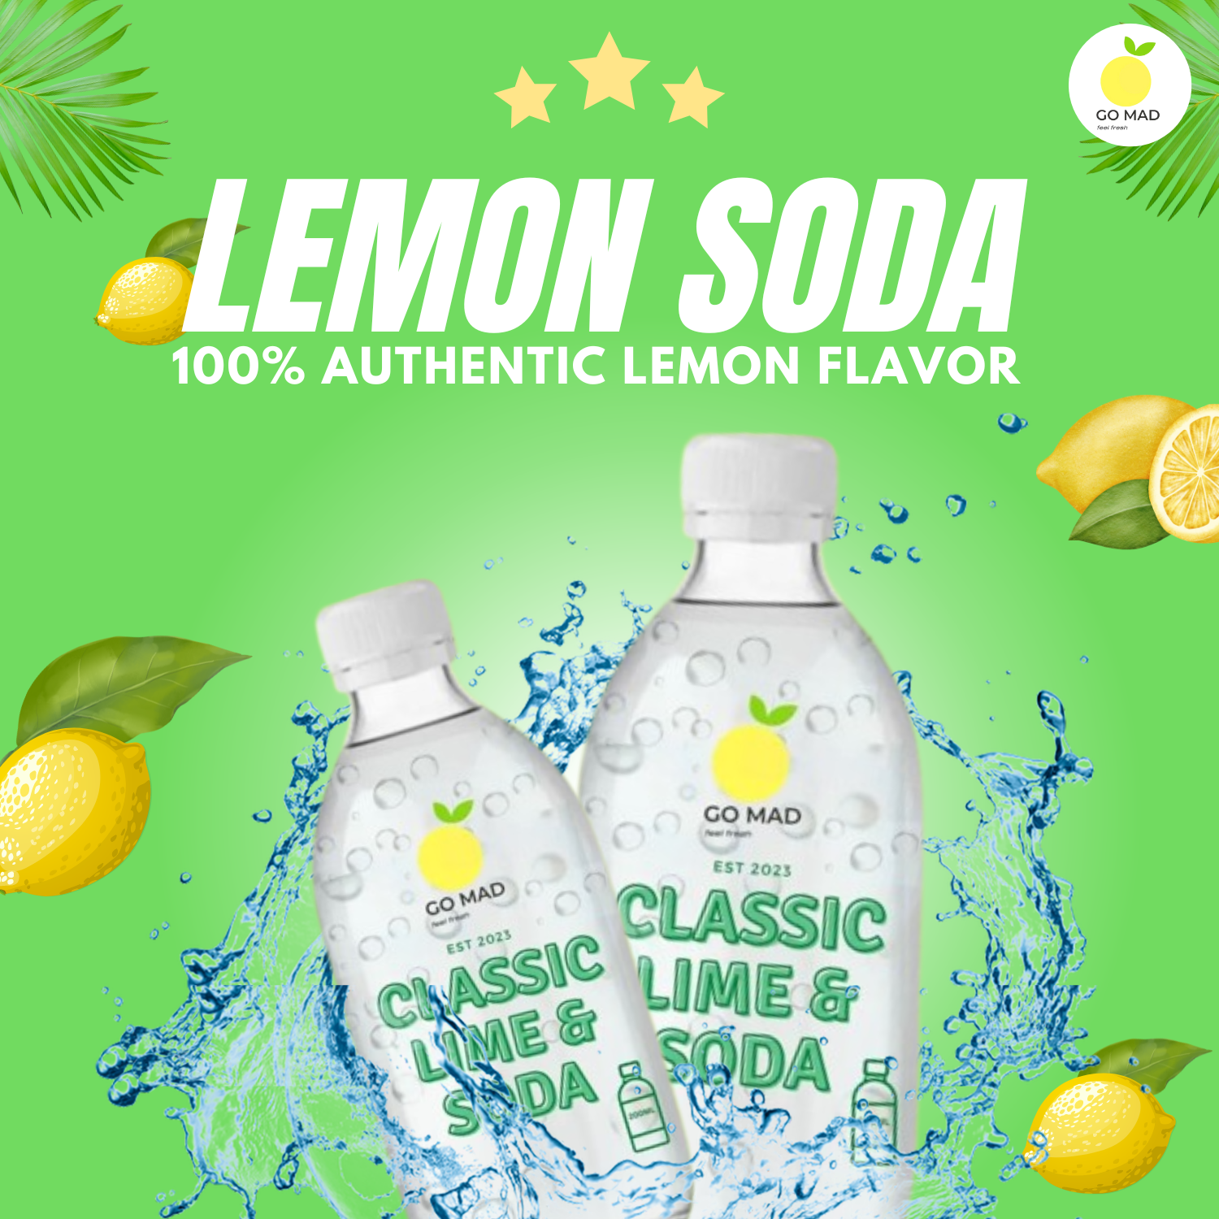
Introduction
This is an entrepreneur idea of our team where we bring back our heritage and healthy drink in a name of (GoMad) to present market .
Our product comes under Fast-moving consumer goods(FMCG) are products that sell quickly at relatively low cost. These goods are also called consumer packaged goods.
In a name of GoMad we not only serve classic lime soda we also serve different flavours to attract different segment of people that is ranging age group of(15-45years)

Slide 4
Vision
Our Main Vision is to serve our heritage drink to present generation

Slide 5
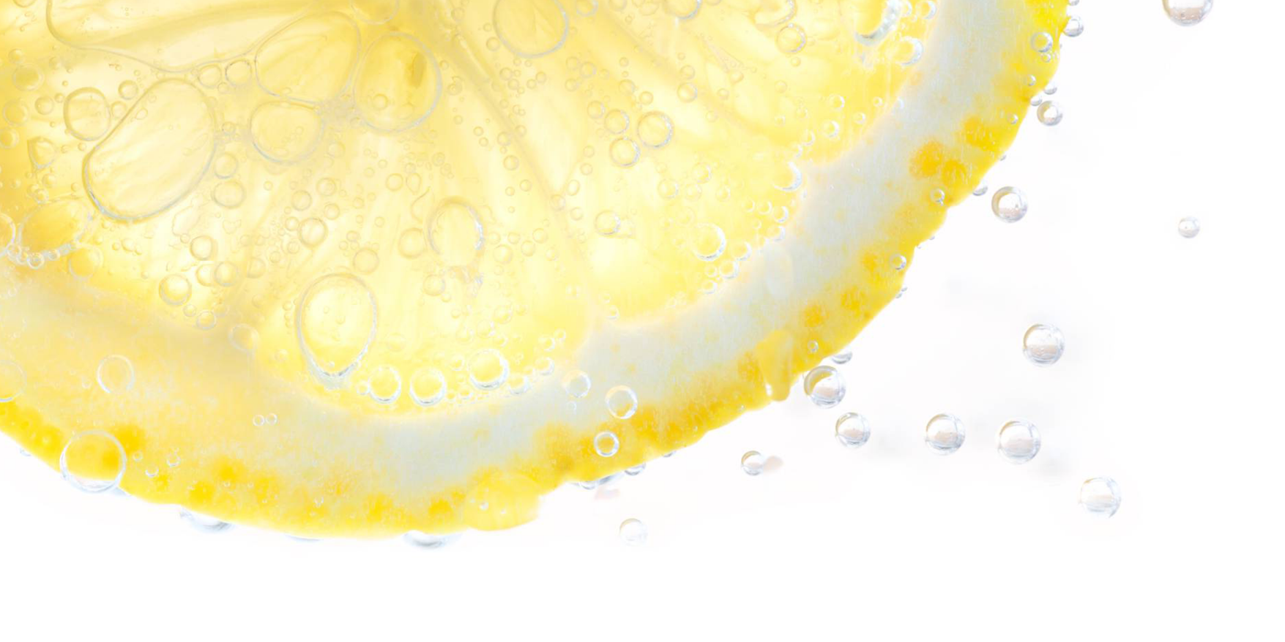
GoMad
The above Is the problem statement, Now we will discuss how we make our brand successful through digital and social media marketing and other various factors

Slide 6

The way to get started is to quit talking and begin doing.

Slide 7
Various Digital and Social Media Used
INSTAGRAM
YouTube
Facebook
Officially Website(Shortly)

Slide 8
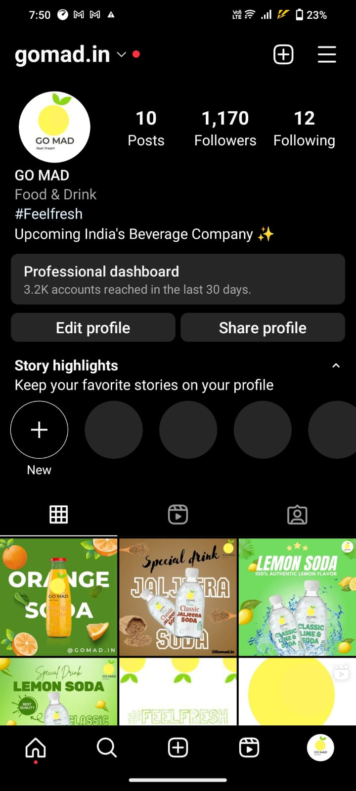
Instagram Page overview
As we have discussed we have official Instagram page, Now look into page insights
We have almost 1000 followers and 12posts where we give regular updates about our brand and flavours available we see some of posts where are posted different flavours(i.e jeera, orange)

Slide 9

Instagram
In recent time the most used app in India and in world wide is Instagram so we targeted this platform as best to start with, So we started creating our official page in Instagram which is handled by one of team mates. Here we post regular updates of different drinks available (i.e sodas of different flavours) and offers available to it. Here we our strong target audience in sense the age group of (15-23years) mostly uses these app as per latest statistics released by Instagram. So here we play ads of different flavours of soda(strawberry, jeera, blueberry, raspberry and many more) which attracts the present youth.
Official page link: https://instagram.com/gomad.in?igshid=ZDdkNTZiNTM=

Slide 10
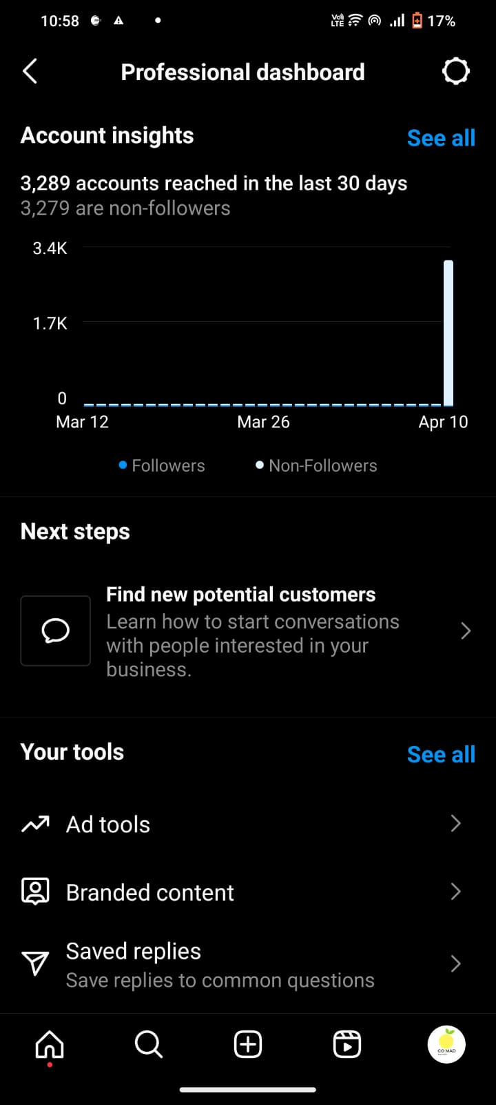
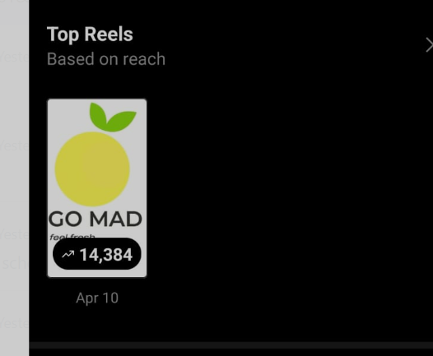
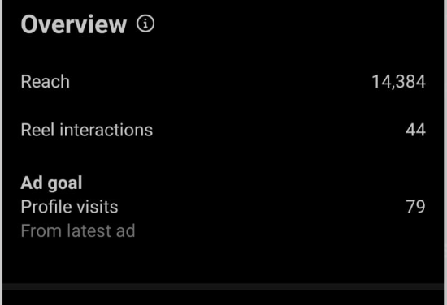
In recent times we posted our ad in Instagram, lets see how this impacted our audience
We recently created a ad and posted in Instagram which reached 3,289accounts and we a have 14,384 views and number of people who visited our account through this ad is 79. The conversion rate nearly (5%) we defiantly increase our conversion rate through attractive post, we not only make customer to view our page we make them to buy , conversion it would (1% to 1.5%). This as beinging it’s a great conversion as we experience we defiantly have huge conversion rate through insatagarm not only that we make our brand as popular.

Slide 11

Facebook
We can observe that most widely using app after Instagram is Facebook lets look how Facebook helping in our brand building
We have a strong target audience here of all age groups you can find (10 years boy to 50 years uncles using this app), So what we have done here is we generalized the ad in sense we are posting all our flavours to unlike Instagram we not only stick to the youth but to everyone (basic to premium flavours)
Link : https://www.facebook.com/profile.php?id=100089981147961&mibextid=ZbWKwL

Slide 12
How we achieve this
We discussed about marketing till now, We will now have glance how and where our products is available ?
Our product has wide range of attraction in summer (this year 2023 May 1st ) we gone Launch our product in Kurnool a 3rd largest city in Andhra Pradesh . Where city has huge fan base for soda and we think this a right time to enter a market. First we start our own outlet and gradually we supply to all shops and malls and we supply to all functions and catering services in the city with (range of 50kms) with the minimum order value
And weekly once we supply to nearby cities (i.e Bangalore and Hyderabad (350 km from Kurnool) Here we more concentrate on various flavors and premium products of our GoMad.
And we concentrate in tourist places too and we are collaborating with Haritha Tourism which is very popular in Andhra and Telangana.

Slide 13

YouTube
https://www.youtube.com/watch?v=yS6t7ebDMXQ

Slide 14

Official Website
GOMAD.IN (This website is still not patent, so we will be taking rights on that in the future and we use that as main stream for selling the products)

Slide 16
Thank you

